Slide 1

Unit 1
How can we become good
learners?
Section B 2a-3a

Slide 2
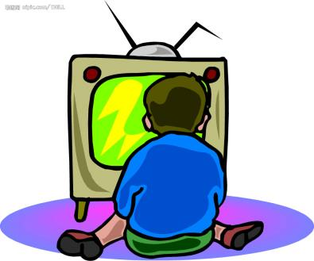
Review
根据所给图示用适当的词汇完成句子。
She learns English _________________
__________________.
by watching
English-language TV

Slide 3

2. She learns English ______________
____________.
by reading the
textbook

Slide 4
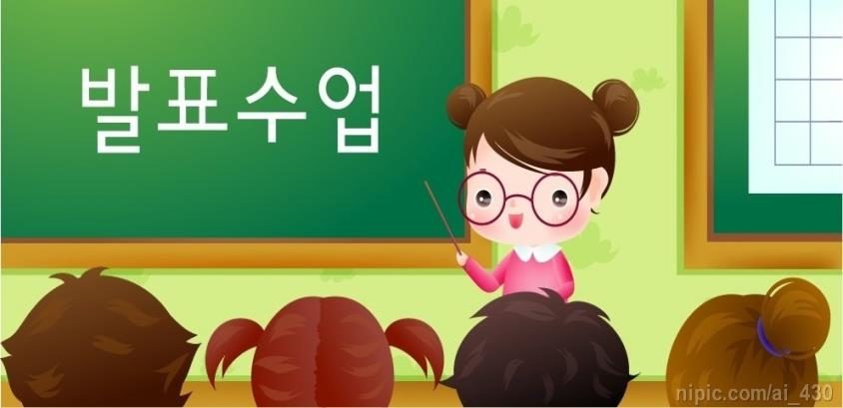
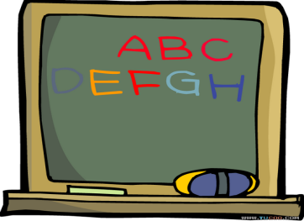
3. They learn English _____________
_________________.
by asking the
teacher for help

Slide 5

music
PPT模板：www.1ppt.com/moban/ PPT素材：www.1ppt.com/sucai/
PPT背景：www.1ppt.com/beijing/ PPT图表：www.1ppt.com/tubiao/
PPT下载：www.1ppt.com/xiazai/ PPT教程： www.1ppt.com/powerpoint/
资料下载：www.1ppt.com/ziliao/ 范文下载：www.1ppt.com/fanwen/
试卷下载：www.1ppt.com/shiti/ 教案下载：www.1ppt.com/jiaoan/
PPT论坛：www.1ppt.cn PPT课件：www.1ppt.com/kejian/
语文课件：www.1ppt.com/kejian/yuwen/ 数学课件：www.1ppt.com/kejian/shuxue/
英语课件：www.1ppt.com/kejian/yingyu/ 美术课件：www.1ppt.com/kejian/meishu/
科学课件：www.1ppt.com/kejian/kexue/ 物理课件：www.1ppt.com/kejian/wuli/
化学课件：www.1ppt.com/kejian/huaxue/ 生物课件：www.1ppt.com/kejian/shengwu/
地理课件：www.1ppt.com/kejian/dili/ 历史课件：www.1ppt.com/kejian/lishi/
4. She learns English ____________
_____________.
by enjoying
English songs
Notes:
PPT模板：www.1ppt.com/moban/ PPT素材：www.1ppt.com/sucai/
PPT背景：www.1ppt.com/beijing/ PPT图表：www.1ppt.com/tubiao/
PPT下载：www.1ppt.com/xiazai/ PPT教程： www.1ppt.com/powerpoint/
资料下载：www.1ppt.com/ziliao/ 范文下载：www.1ppt.com/fanwen/
试卷下载：www.1ppt.com/shiti/ 教案下载：www.1ppt.com/jiaoan/
PPT论坛：www.1ppt.cn PPT课件：www.1ppt.com/kejian/
语文课件：www.1ppt.com/kejian/yuwen/ 数学课件：www.1ppt.com/kejian/shuxue/
英语课件：www.1ppt.com/kejian/yingyu/ 美术课件：www.1ppt.com/kejian/meishu/
科学课件：www.1ppt.com/kejian/kexue/ 物理课件：www.1ppt.com/kejian/wuli/
化学课件：www.1ppt.com/kejian/huaxue/ 生物课件：www.1ppt.com/kejian/shengwu/
地理课件：www.1ppt.com/kejian/dili/ 历史课件：www.1ppt.com/kejian/lishi/

Slide 6


2a What good learning habits can you think of? Make a list and discuss them with your partner.

Slide 7
2b Read the passage quickly and check if any of the habits you listed in 2a are mentioned. Which four habits of successful learners can you find from the passage?
USING DICTIONARIES
This can help you find the definition that matches the context of the word in the text.

Slide 8
How Can You Become a Successful Learner?
Everyone is born with the ability to learn.
But whether or not you can do this well depends on your learning habits. Research
shows that successful learners have some good habits in common.
Creating an interest in what they learn
Studies show that if you are interested in something, your brain is more active and

Slide 9
it is also easier for you to pay attention to it for a long time. Good learners often connect what they need to learn with something interesting. For example, if they need to learn English and they like music or sports, they can listen to English songs or watch sports programs in English. This way they will not get bored.
Practicing and learning from mistakes
Good learners think about what they are good

Slide 10
at and what they need to practice more. Remember, “use it or lose it”! Even if you learn something well, you will forget it unless you use it. “Practice makes perfect.” Good learners will keep practicing what they have learned, and they are not afraid of making mistakes. Alexander Graham Bell did not invent the telephone overnight. He succeeded by trying many times and learning from his mistakes.

Slide 11
Developing their study skills
It is not enough to just study hard. Good learners know the best ways they can study. For example, they may take notes by writing down key words or by drawing mind maps. They also look for ways to review what they have learned. They may do this by reading their notes every day or by explaining the information to another student.

Slide 12

Asking questions
Good learners often ask questions during or
after class. They even ask each other and try to find out the answers. Knowledge comes from questioning.
Learning is a lifelong journey because every day brings something new.
Everything that you learn
becomes a part of you and
changes you, so learn wisely
and learn well.

Slide 13
Language Points
1. Everyone is born with the ability to learn.
But whether or not you can do this well
depends on your learning habits.
Be born 意为“天生，出生”为被动语态 E.g. I was born in a small village.
我出生在一个小山村。
He was born to succeed in life.
他生来注定会成功。

Slide 14
(2) ability 在此处为不可数名词，意为“能力”常构成短语 have the ability to do sth. ( 有能力做某事)
Man has the ability to speak.
人类有说话的能力。
(3) whether or not 意为“是否” whether引导主语从句，不能与if 替换。
whether she will come or not is still a problem. 她是否会来还是个问题。

Slide 15
(4) Depend on 意为“ 视……而定，取决于；依靠；依赖 。后接名词，代词或动名词。既不能用于进行时态也不能用于被动语态。
We depend on the newspaper for daily news.
我们得靠报纸得知每天的消息。
You may depend on his coming.
你可以相信他会来。

Slide 16
2. Studies show that if you are interested in something, your brain is more active and it is also easier for you to pay attention to it for a long time.
Active –adj, “活跃的，积极的” 可作表语
或定语。常用短语：take an active part in,
意为“积极参加”
Although he is over 80, he is still very active.
他虽然年过八十，但是仍很活跃。

Slide 17
We all take a part in the sports meeting.
我们都积极参加运动会。
(2) pay attention to 意为“注意，关注”，其中to 为介词，其后可接名词、代词或动词-ing形式。
You’d better pay attention to this word in the
English exam last time.
你最好注意一下上次英语考试中的这个单词。

Slide 18
3. Good learners often connect what they need to learn with something they are interested in.
(1) connect…with…意为“ 把……和……联系起来” 其名词形式为connection，意为“连接；关系”
Please don’t connect this person with that person. 请不要把这个人和那个人联系在一起。

Slide 19
4. Good learners think about what they are good at and what they need to practice more.
  Think about 意为“考虑”其后接名词、代词、动词-ing形式或宾语从句。
They are thinking about a serious problem.
他们正在考虑一个严肃的问题。
(2) Be good at “擅长” 同义于 do well in “在某方面做得好”
He is good at English.= he does well in English.

Slide 20
5. Even if you learn something well, you will forget it unless you use it.
（1）Even if 意为“即使，尽管”，用于引导让步状语从句，有退一步设想的意味，同义于“even though”
I’ll help you, even if I must stay up the whole night. 即使熬夜一整晚我也要帮助你。
（2） forget 后直接跟名词、代词、动词不定式或动词-ing形式，但两者意义完全不同。

Slide 21
Forget to do sth 和forget doing sth.
Forget to do sth: 忘记去做某事
forget doing sth. 忘记做过某事
e.g. I forget to turn off the light.
我忘记关灯了。
I forget turning off the light.
我忘记已经关灯了。

Slide 22
6. They also look for ways to review what they have learned.
（1）look for 意为“寻找” 后跟名词或代词作宾语。
E.g. they are looking for the missing child.
他们在寻找失踪的孩子。
比较：look for, find与 find out

Slide 23
Look for: 寻找，强调寻找的动作和过程，是
有目的的寻找。
find: 找到，发现，通常指找到或发现具体的东西，也可指偶然发现某物或某种情况，强调结果。
Find out: 弄清，查明，多指通过调查、询问、研究后搞清楚、弄明白，含经过困难、曲折的意味。

Slide 24
2c Read the passage again and answer the questions.
Does the writer think that everyone is born
with the ability to learn well? Do you agree?
Why or why not?
No. No, I don’t. Because whether or not you
can learn well depends on your learning habits.

Slide 25
2. Why is it a good idea to connect something
you need to learn with something you are
interested in?
Because if you are interested something, your
Brain is more active and it is also easier for
You to pay attention to it for a long time.

Slide 26
3. What do the sayings “use it or lose it” and
“practice makes perfect” mean? Do you
agree with them?
We should keep practicing what we have learned. Even if we learn something well, we will forget it until we use it. Yes, I do.
4. Do good learners learn from mistakes or
are they afraid of making mistakes?
Good learners learn from mistakes.

Slide 27
5. What study skills does the writer talk
about? Do you have those study skills?
Creating an interest in what you learn, practicing and leaning from mistakes, developing study skills and asking questions. Yes, I do./ No, I don’t.
6. Do you agree that learning is a lifelong
journey? Why or why not?
Yes, I do. Because every day brings something new.

Slide 28
2d Look up the following words from the
passage in the dictionary. Then write a sentence for each word.
brain n. connect v. overnight adv.
attention n. review v. knowledge n.
ability n. active adj. wisely adv.
e.g. brain: A good way to train the brain is to
do some math exercises every day

Slide 29
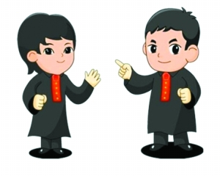
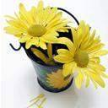
2e Do you think you are a good learner? What learning habits do you think are useful? Discuss with your group and share your ideas with the class.

Slide 30

Can you think of other ways to become a successful learner? Discuss with your group and share your ideas with the class.
A: I think another way to become a successful
learner is by trying to think about the
same thing in different ways.
B: I agree. I believe that ...

